Slide 1
Information Integration
Project Presentation
Valentina Sisti
1952657

Slide 2
Main Phases
Implementation Phase
03
Data Gathering Phase
01
02
Modeling
Phase
Notes:
The project is divided into 3 main phases:
The data gathering phase
The modeling phase and the implementation phase

Slide 3
Phase 1.
Data Gathering
Notes:
So let’s start with the data gathering phase

Slide 4

Domain of Interest
Music & Spotify
Songs
Artists
Albums
Genres
Lyrics
Charts
Notes:
The first step is actually to define our domain of interest, and the one that I chose is the Music domain in general, with a particular attention towards data coming from Spotify. So in our domain we are considering all that concerns songs, artists and albums, but also genres, lyrics and also data from music charts

Slide 5



Data Collection Phase
tracks.csv
artists.csv
albums.csv
audio_features.csv
r_albums_artists.csv
8+M. Spotify Tracks Dataset
r_albums_tracks.csv
r_artist_genre.csv
r_tracks_artist.csv
Notes:
In particular the first dataset was called 8 plus millions spotify tracks dataset, from which I collected 8 csv files about Spotify tracks, artists, albums and genres.

Slide 6

Data Collection Phase
billboard-hot-100-tracks.csv
Billboard Hot 100 - Full History Dataset
Notes:
The second dataset contains just one CSV file about the full history of the Billboard Hot 100 chart, which is the music industry standard record chart in the United States for songs

Slide 7

Data Collection Phase
genius_lyrics.csv
5 Millions Genius Lyrics Dataset
Notes:
Then we have the 5 Millions Genius Lyrics dataset, where Genius is a very popular website where find lyrics about songs, which had one single csv file about song lyrics

Slide 8


Data Collection Phase
influence_data.csv
The Influence of Music, Spotify and AllMusic Data
Notes:
Another dataset that I found was The Influence of Music, Spotify and AllMusic Data, from which I collected just one single csv file about the influence that artists have had on other artists

Slide 9

Data Collection Phase
record_labels.csv
Record Labels - All Universal Music Group Artists
Notes:
The next dataset is about Record Labels of the Universal Music Group Artists, from which I collected one csv file about record labels of artists with associated their respective Label Group

Slide 10


Data Collection Phase
exp_track_genres.csv
SGTD_tracks_genres.csv
exp_track_labels.csv
Exportify Data
Spotify and Genius Tracks Dataset
Notes:
And finally, the last two datasets are the one from Exportify and the Spotify and Genius Tracks Dataset, containing additional information about Spotify tracks and their associated labels and genres

Slide 11
7 Datasets
15 CSV Files
Notes:
Then the next step was actaully to collect the data and for this step i was able to collect data from 7 different datasets for a total of 15 CSV

Slide 12
Tasks definition
Find out which are the most popular artists, songs or albums
Find out songs of which genre are most likely to reach the Billboard Hot 100, based on the history
Find out if there are some labels that have very popular artists and in turn very popular songs
Find out which is the influence that very important artists have had on other artists
Notes:
The next step was to define some tasks that we want to perform on the data, and some of the tasks that we could perfrom in order to gain some interesting insights from our data are these ones.
So we may want to find out which are the most popular artists, songs or albums,
or which are the genres that are most likely to reach the BillboardHot100 chart,
or maybe find out wheteher there are some labels that have very popular artists and in turn very popular songs
or finally we may be interested in find out which is the influence that some important artsits have had on other artists

Slide 13
Problems of the Data
Conceptual heterogenity
Concept of «id» may refer to Spotify ID, Billboard ID or custom ID internally defined
track_id and audio_feature_id are the same in tracks.csv
Songs’ duration stored in milliseconds
Albums’ release_date stored in epoch format
Notes:
Ok, now of course all these data that we collected has some problems.
While not presenting the problem of Physical Heterogenity, since all the data from the different sources is in the form of a CSV file,
there is however the problem of Conceptual Heterogeneity, so the fact that the different sources describe the domain from different perspectives.
In fact, for instance we may have the concept of ID that in some cases refers to the Spotify ID, in some other to the Billboard ID or even to some other custom ID internally defined
Then another problem is that in the tracks csv file there is the audio feature id, which is exactly the same of the track id, so basically is redundant information
Another problem is that Songs’ duration is stored in milliseconds, which is not very meaningful from our perspective, since we are used to look at songs’ duration in the minutes scale
And then also the Albums’ release date stored in epoch format, which is a format that from our perspective is not understandable at all

Slide 14
Problems of the Data (2)
Some data sources contain a huge volume of data
A great part of it refers to quite unknown artists and songs
In order to gain interesting insights, we want to restrict our discussion to just most relevant artists and songs
Notes:
Another problem of this data is that some of the data sources contain a really huge volume of data, in the scale of millions,
but the majority of it actually refers to pretty much unknown artists and songs.
So, also with respect to the tasks that we have identified, that do not concern very unknown artists,
we are not very interested a great part of this information and actually we want to restrict the discussion to just
more relevant artists and songs, and this will be important to be kepts in mind when we are going to define the mapping later on.

Slide 15
Phase 2.
Modeling
Notes:
Now of course our goal is to provide a reconciled view of these data sources, and for this reason we can now move towards the modeling phase

Slide 16
Information Integration System
Global Schema
Mapping
Source Schema
Notes:
In particular we need to define an Information Integration System, and in order to do that we need to
Provide the formal description of how the data sources looks like, using the Source Schema
Provide the formal description of the result of the integration process using the Global Schema
And finally Reconcile Source and Global schema by defining and using the Mapping layer
So that at the end we will be able to define Queries over the Global schema to perform the tasks that we identified

Slide 17
Source Schema
$$Artists8M(name, id, popularity,followers)$$
$$Songs8M(id, disc_number, duration, explicit, audio_feature_id, name,$$ $preview_url, track_number, popularity, is_playable)$
$$Albums8M(id, name, album_group, album_type, release_date, popularity)$$
$$TracksArtists8M(track_id, artist_id)$$
$$AlbumsTracks8M(album_id, track_id)$$
$$AlbumsArtists8M(album_id, artist_id)$$
$$ArtistsGenres8M(artist_id, genre)$$
Notes:
Let’s start with the Source Schema, which is the formal definition of what the data sources contain
So as we can see I have defined the first one which is Artists8M (where the 8M simply means that we are referring to the 8+Millions Spotify tracks dataset) in which we have for instance the name, the id, the popularity and the followers of an artist.
And Similarly, by looking at all the other csv files, we can define the other ones, so Songs and Albums, and then the last 4 that are the one that formally describes the CSV files from 8+M dataset that contain the relationships between tracks and artists, artists and albums, albums and tracks and so on.

Slide 18
Source Schema (2)
$$GeniusLyrics(title, tag, artist, year,views,features,lyrics,id)$$
$$BillboardFullHistory(billboard_id,rank, date, artist,title,last_week,$$
$weeks_on_chart,peak_rank)$
$$Influence(influencer_name, influencer_main_genre, influencer_active_start, \\ follower_name, follower_main_genre, follower_active_start)$$
$$AudioFeatures8M(id, acousticness, danceability, duration, energy, instrumentalness,$$
$key,liveness, loudness, mode, speechiness, tempo, time_signature)$
Notes:
Then, similarly, we have the other Source Schema predicates, so the one for the GeniusLyrics source, for the BillboardFullHistory source and for the Influence data source, as well as the AudioFeatures from the 8+M dataset,
which basically contains information about characteristics of spotify tracks such as how much the song is acoustic, danceable or loud, as well as the level of energy, liveness, instrumentalness and so on

Slide 19
Source Schema (3)
$$SGTDTracksGenres(artist_popularity, followers,genre, id,name, \\ track_id,track_name_prev,type)$$
$$ExportifyTracksGenres(track_URI, track_name,artist_id, artist_name,album_URI, \\ album_name,track_id,genre)$$
$$ExportifyTracksLabels(track_URI, track_name,artist_id, artist_name, track_id,genre)$$
$$RecordLabels(id,group,label,artist_name)$$
Notes:
And finally we have a third batch of source schema predicates, this time relative to the sources containing data about genres and labels from Exportify, and to the RecordLabels dataset, containing information about Labales in relation to the particular Label Group they belong to

Slide 20
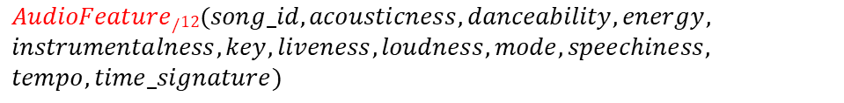
Global Schema
$$Song/7(id, name, popularity, track_number,duration,explicit,preview_url)$$
$$Artist/4(id, name, popularity, followers)$$
$$Album/6(id, name, album_type, popularity, release_date)$$
$$BillboardHot100Song/5(song_id, rank, date, weeks_on_chart, peak_rank)$$
$$AudioFeature/12(song_id, acousticness, danceability, energy,$$
$$instrumentalness, key, liveness, loudness, mode, speechiness,$$
$$tempo, time_signature)$$
Notes:
Then the next step is to describe the Global Schema, and
of course in our Global schema we want to define the basic predicates for Songs, Artist and Albums, with just the most relevant attributes, then we want to define BillboardSong, to have the information about songs that appeared in the BillboardHot100 chart, then we have the AudioFeature predicate for our songs features

Slide 21
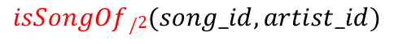
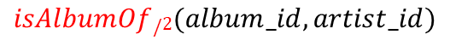
Global Schema (2)
$$isSongOf/2(song_id, artist_id)$$
Song with «song_id» is performed by Artist with «artist_id»
$$isSongInAlbum/2(song_id, album_id)$$
Song with «song_id» is in Album with «album_id»
$$isAlbumOf/2(album_id, artist_id)$$
Album with «album_id» is of Artist with «artist_id»
Notes:
Then we also want to define some binary predicates in our Global Schema that are the ones that define the relationships between our basic concepts, so we have isSongOf, which means that the song with a particular song_id is performed by an artist with a particular artist_id, and similarly we do the same with isSongInAlbum and isAlbumOf, which represent the fact that a song is present in a particular album and an album is of a particular artist respectively

Slide 22
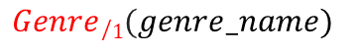

Global Schema (3)
$$Genre/1(genre_name)$$
$$doesGenre/2(artist_id, genre_name)$$
Artist with «artist_id» does the music Genre «genre_name»
$$hasInfluenced/2(artist_id1, artist_id2)$$
Artist with «artist_id1» has influenced Artist with «artist_id2»
$$hasLyrics/2(song_id, lyrics)$$
Song with «song_id» has Lyrics «lyrics»
Notes:
Then we have the Genre predicate, as well as the binary predicate doesGenre, which represent the fact that a particular artist does a particular genre, and then we have also these other two binary predicates which represent the fact that the artist with artist_id1 has influenced the artist with artist_id2 and that a song with a particular song_id has some particular lyrics

Slide 23
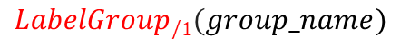
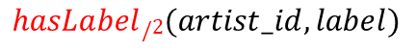
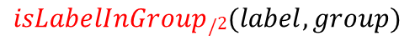
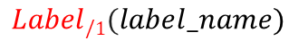
Global Schema (4)
$$Label/1(label_name)$$
$$LabelGroup/1(group_name)$$
$$hasLabel/2(artist_id,label)$$
Artist «artist_id» has published a Song under the Label «label»
$$isLabelInGroup/2(label, group)$$
Label «label» belongs to the Label Group «group»
Notes:
And finally we define the predicates for Labels and LabelGroups, as well as the binary predicates that represent the fact that a particular artist has published a Song under a particular label and that a particular label belongs to a particular group of labels

Slide 24
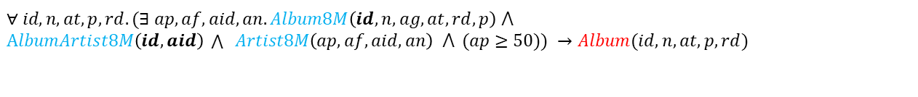
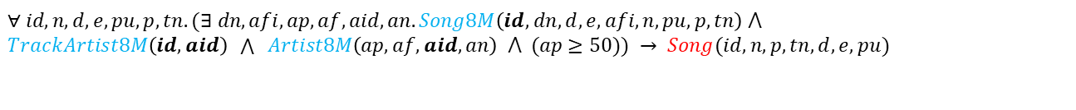
Conjunctive GAV Mapping
Artist:
$$∀ id, n, p, f.(Artist8M\left(p, f,id,n\right) ⋀ (p≥50))→Artist(id, n, p, f)$$
Song:
$$∀ id,n,d,e,pu,p,tn.(∃ dn,afi,ap,af,aid,an.Song8M\left(id,dn,d,e,afi,n,pu,p,tn\right) ⋀$$
$TrackArtist8M\left(id, aid\right) \bigwedge{ Artist8M\left(ap, af,aid,an\right) ⋀ (ap≥50)}) → Song(id, n,p,tn,d,e,pu)$
Album:
$$∀ id,n,at,p,rd.(∃ ap,af,aid,an.Album8M\left(id,n,ag,at,rd,p\right) ⋀$$
$AlbumArtist8M\left(id, aid\right) \bigwedge{ Artist8M\left(ap, af,aid,an\right) ⋀ (ap≥50)}) →Album(id, n,at,p,rd)$
Notes:
And then the last step of our Modeling phase is actually to define the Mapping, so the layer that represents the relationship between our Source and Global schemas.
What is important to point out is that I defined a GAV Mapping, in fact, as we can see on the right side of the mapping we have a single atom of the Global Schema while on the left side we have a query over the source schema, and in particular it is also a Conjunctive GAV mapping becasue as we can see because the all the queries that we have on the left side are actually conjunctive queries.
)
Ok as we said at the beginning, based on the tasks that we have identified, we wan to restrict our data to just concerning most relevant artists, and so in order to do this, it is now in the mapping that we can define that we want to map an artist from the Artist8M source into our Artist predicate of the global schema only if it has popularity greater than 50, and this condition, will reflect also to all the other mapping assertions that we are going to define.
In fact, as we can see here, we also want to map Songs and Albums only if they belong to artists that have the popularity greater than 50.

Slide 25
Conjunctive GAV Mapping (2)
isSongOf:
$$∀ sid, aid.(∃ p,f,n. TrackArtist8M\left(sid,aid\right) ⋀ Artist8M(p,f,aid,n) ⋀ (p≥50))→isSongOf\left(sid,aid\right)$$
isSongInAlbum:
$$∀ sid, albid.(∃ p,f,aid,n. AlbumTrack8M\left(sid,albid\right) ⋀ TrackArtist8M(sid, aid) ⋀$$
$$Artist8M(p,f,aid,n) ⋀ (p≥50))→isSongInAlbum(sid,albid)$$
isAlbumOf:
$$∀ albid, aid.(∃ p,f,n. AlbumArtist8M\left(albid,aid\right) ⋀ Artist8M(p,f,aid,n) ⋀ (p≥50))→isAlbumOf(albid,aid)$$
Notes:
And we do this reasoning also for the other mapping assertions, so for isSongOf, isSongInAlbum and isAlbumOf, as we can see here, where here maybe the most elaborated one is isSongInAlbum, because we want to map a relationship, let’s say, between a song and an album only if that particular song is a song that is performed by an artist that has popularity greater than 50, to do so we also need to check the song id put in our global schema a relationship between to have that a song with a song id sid belongs to the album with album id albid, but then we also need to get the artist_id to which this album belongs to and finally check whether this particular artist has the popularity greater than 50

Slide 26
Conjunctive GAV Mapping (3)
AudioFeature:
$$∀ sid,a,d,e,i,k,li,lo,m,s,t,ts.(∃ ap,af,aid,an, du.$$
$$AudioFeature8M\left(sid,a,d,du,e,i,k,li,lo,m,s,t,ts\right) ⋀ TrackArtist8M\left(sid,aid\right) ⋀$$
$$Artist8M\left(ap, af,aid,an\right) ⋀ (ap≥50) →AudioFeature(sid,a,d,e,i,k,li,lo,m,s,t,ts)$$
Genre:
$$∀ genre.(∃tu,tn,aid,an,alu,aln,tnb.$$
$ExportifyTracksGenres\left(tu, tn,aid,an,alu, aln,tnb, genre\right)→Genre(genre)$
$∀ genre.(∃ p,f,id,n,tid,tnp,t. SGTDTracksGenres\left(p,f,genre,id,n,tid,tnp,t\right))→Genre(genre)$
$∀ genre.(∃artist_id. ArtistGenre8M\left(artist_id, genre\right)) →Genre(genre)$
Notes:
Then, for both Genre and DoesGenre we have not just one but 3 mapping assertions because we have the genre information from 3 different sources, so we have one mapping assertion in which we consider the the Exportify
and in this case we have not just one but 3 mapping assertions since we have data about genres from 3 different sources and for each of this we will need one mapping assertions.

Slide 27
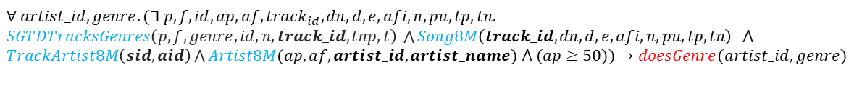
Conjunctive GAV Mapping (4)
doesGenre:
$$∀ artist_id,genre.(∃ ap,af,artist_name,tu,tn,alu,aln,tnb.$$
$$ExportifyTracksGenres\left(tu, tn,artist_id,artist_name,alu, aln,tnb, genre\right) ⋀$$
$Artist8M(ap,af,artist_id,artist_name) ⋀ (ap≥50))→doesGenre(artist_id,genre)$
$$∀ artist_id,genre.(∃ p,f,id,ap,af,track_{id}, dn,d,e,afi,n,pu,tp,tn.$$
$SGTDTracksGenres\left(p,f,genre,id,n,track_id,tnp,t\right) \bigwedge{Song8M\left(track_id,dn,d,e,afi,n,pu,tp,tn\right)} ⋀$ $TrackArtist8M\left(sid,aid\right)\bigwedge{Artist8M(ap,af,artist_id,artist_name) ⋀ (ap≥50))}→doesGenre(artist_id,genre)$
$$∀ artist_id,genre.(∃ap,af,artist_name. ArtistGenre8M\left(artist_id, genre\right) ⋀$$
$Artist8M(ap,af,artist_id,artist_name) ⋀ (ap≥50))→doesGenre(artist_id,genre)$
Notes:
Then, for both Genre and DoesGenre we have not just one but 3 mapping assertions because we have the genre information from 3 different sources, so we have one mapping assertion in which we consider the the Exportify
and in this case we have not just one but 3 mapping assertions since we have data about genres from 3 different sources and for each of this we will need one mapping assertions.

Slide 28
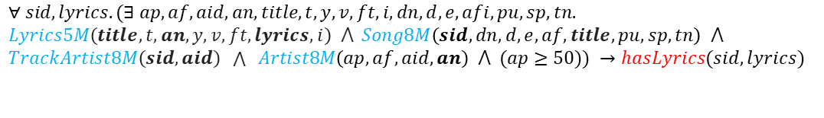
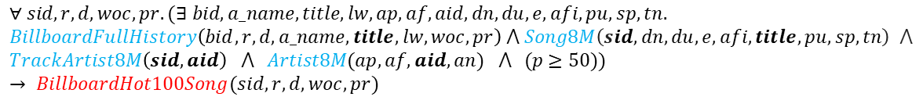
Conjunctive GAV Mapping (5)
hasLyrics:
$$∀ sid,lyrics.(∃ ap,af,aid,an,title,t,y,v,ft,i,dn,d,e,afi,pu,sp,tn.$$
$$Lyrics5M\left(title,t, an,y,v,ft,lyrics, i\right) ⋀ Song8M\left(sid,dn,d,e,af,title,pu,sp,tn\right) ⋀$$
$TrackArtist8M\left(sid,aid\right) \bigwedge{ Artist8M\left(ap, af,aid,an\right) ⋀ (ap≥50)}) →hasLyrics(sid,lyrics)$
BillboardHot100Song:
$$∀ sid,r,d,woc,pr.(∃ bid,a_name,title,lw,ap,af,aid,dn, du,e,afi,pu,sp,tn.$$
$$BillboardFullHistory\left(bid,r,d,a_name,title,lw,woc,pr\right) ⋀ Song8M\left(sid,dn,du,e,afi,title,pu,sp,tn\right) ⋀$$
$$TrackArtist8M\left(sid,aid\right) ⋀ Artist8M(ap,af,aid,an) ⋀ (p≥50))→ BillboardHot100Song(sid,r,d,woc,pr)$$
Notes:
Then we have the mapping for AudioFeature, in which the concept is the same as before.
And then here we have the mapping for hasLyrics and for hasInfluenced, which are a bit different because this time we don’t have the spotify id in these files,

Slide 29
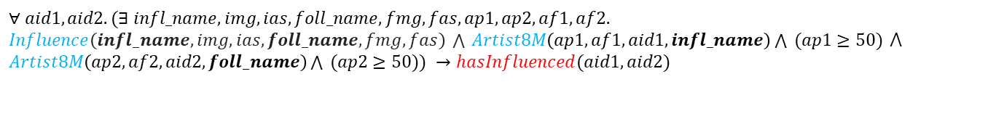
Conjunctive GAV Mapping (6)
hasInfluenced:
$$∀ aid1,aid2.(∃ infl_name,img, ias,foll_name,fmg,fas,ap1,ap2,af1,af2.$$ $Influence\left(infl_name, img,ias,foll_name,fmg,fas\right) \bigwedge{ Artist8M\left(ap1, af1,aid1,infl_name\right)\bigwedge{ (ap1≥50)} ⋀}$ $Artist8M\left(ap2, af2,aid2,foll_name\right)\bigwedge{ (ap2≥50)}) →hasInfluenced(aid1,aid2)$
Label:
$∀ label.(∃ tu,tn,aid,an,tnb.$ $ExportifyTracksLabels\left(tu, tn,aid,an, tnb, label\right))→Label(label)$
$∀ label.(∃ id,group, artist_name.RecordLabels\left(id, group,label,artist_name\right))$→ $Label(label)$
Group:
$∀ group.(∃id,label,artistname.RecordLabels\left(id, group,label,artist_name\right))$ → $Group(group)$

Slide 30
Conjunctive GAV Mapping (7)
hasLabel:
$∀ label,artist_id.(∃ ap,af,aid,an,tu,tn,tnb.$
$ExportifyTracksLabels\left(tu, tn,artist_id,an, tnb, label\right)$ ⋀
$Artist8M(ap,af,artist_id,an) ⋀ (ap≥50))→hasLabel(artist_id,label)$
$$∀ label,artist_id.(∃ ap,af,aid,artist_name,id,group.$$
$$RecordLabels\left(id, group,label,artist_name\right) ⋀ Artist8M\left(ap,af,artist_id,artist_name\right) ⋀$$
$(ap≥50))$ → $hasLabel(artist_id,label)$
isLabelInGroup:
$$∀ label,group.(∃ ap,af,aid,artist_name,id,group.$$
$RecordLabels\left(id, group,label,artist_name\right) ⋀ Artist8M\left(ap,af,aid,artist_name\right)$ ⋀
$(ap≥50))$ → $isLabelInGroup(label,group)$

Slide 31
The Query Answering Problem
It can be proved that, given the Retrieved Global Database, in the case of Conjunctive GAV Mapping, we can compute certain answers for CQ and UCQ.
Now, in order to compute and obtain the RGDB, we can exploit the Materialization-based approach in the GAV context, simply by materializing the global schema views.
In order to do this in practice, we can exploit a data integration tool and this leads us to the final phase of the project: the Implementation Phase.
Notes:
Now that we have the Mapping we can finally reason on the Query Answering Problem
In particular, since both the Source and the Global schema were empty theories,
because we didn’t defined any constraint on them, and since
the Mapping that we defined was a conjunctive GAV mapping,
it can be proved that if we compute the Retrieved Global Databasem we are actually able to compute certain answers.
And luckily in the GAV context we have that we can actually compute the Retrieved Global Databse
by simply materializing the global schema views (by materializing the result of the queries that define the GAV mapping).
And so, in order to this in practice, we can exploit a data integration tool, so we can now finally move to the final phase of the project which is the implementation phase.

Slide 32
Phase 3.
Implementation

Slide 33

Data Integration Tool: Talend
Talend is the leader tool in cloud and big data integration
Fully open source
Embeds existing Java code libraries and allows to create custom components
Allows to easily integrate data from different sources thanks to a GUI
Notes:
In particular, the data integration tool that I have and for this purpose my choice was Talend,
since it is the leader in cloud and big data integration,
is fully open source,
And allows us to easily perform data integration by means of a graphical user interface

Slide 34
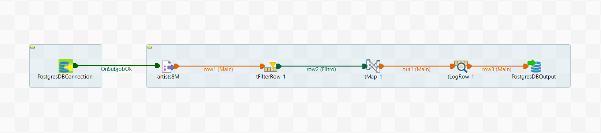
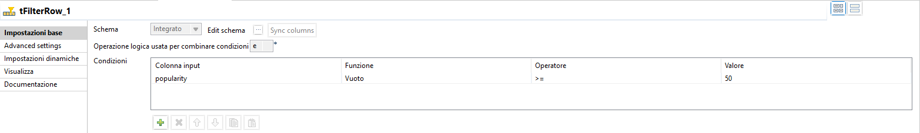
Artists
Notes:
In Talend we can define different Jobs. The one that we see in this slide is the one for artists, which has a very basic structure: in fact first of all we need to open the connection over our destination database, that in this case is a Postgres Database, and then, from the artists8M csv file we go to a filterrow component that will filter just the artists with popularity greater than 50, as we can see here, then we have a tMap to just select the attributes we are interested in and finally we log the results and we finally materialize the output in the artists table of our Postgres database

Slide 35
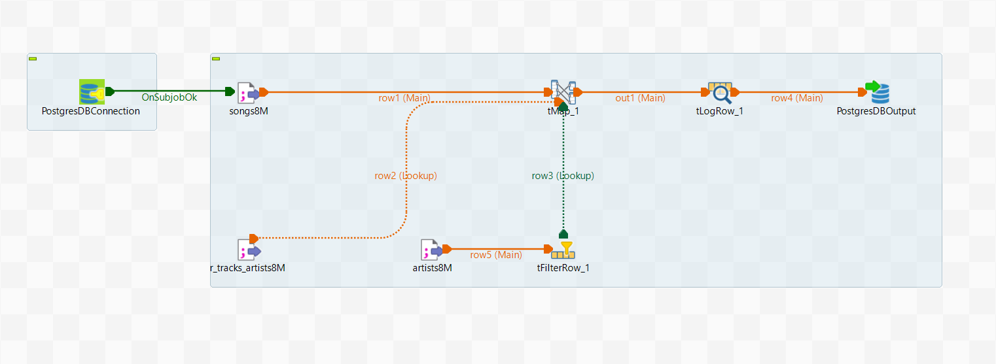
Songs
Notes:
Then, similarly, we have the job for songs, which is a bit more structured, and this is beacuse we just want to map songs about artists that have a popularity greater than 50, and for doing this we need also the lookup for checking by which artist a particular song is performed.

Slide 36
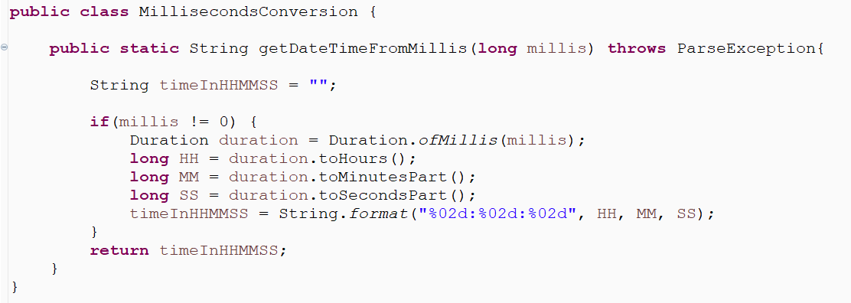
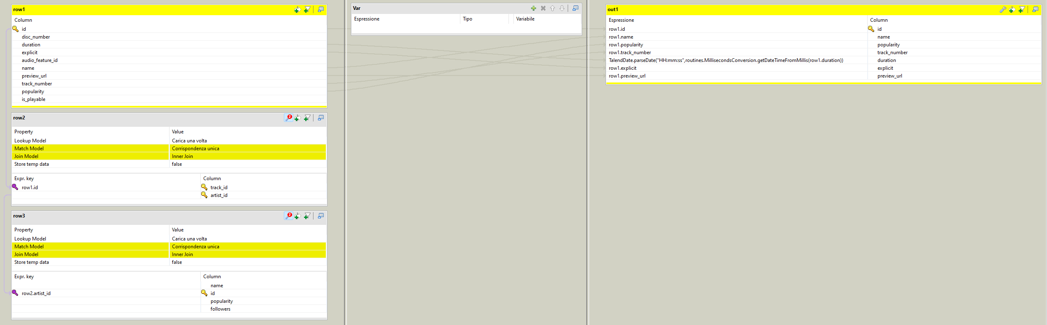
Songs - tMap
Notes:
These are the details of our tMap component, and in particular here, because the duration of songs was stored in milliseconds, I defined a custom global routine, which is basically a Java class with some methods, with one single method to convert the milliseconds into a DateTime format with hours, minutes and seconds

Slide 37
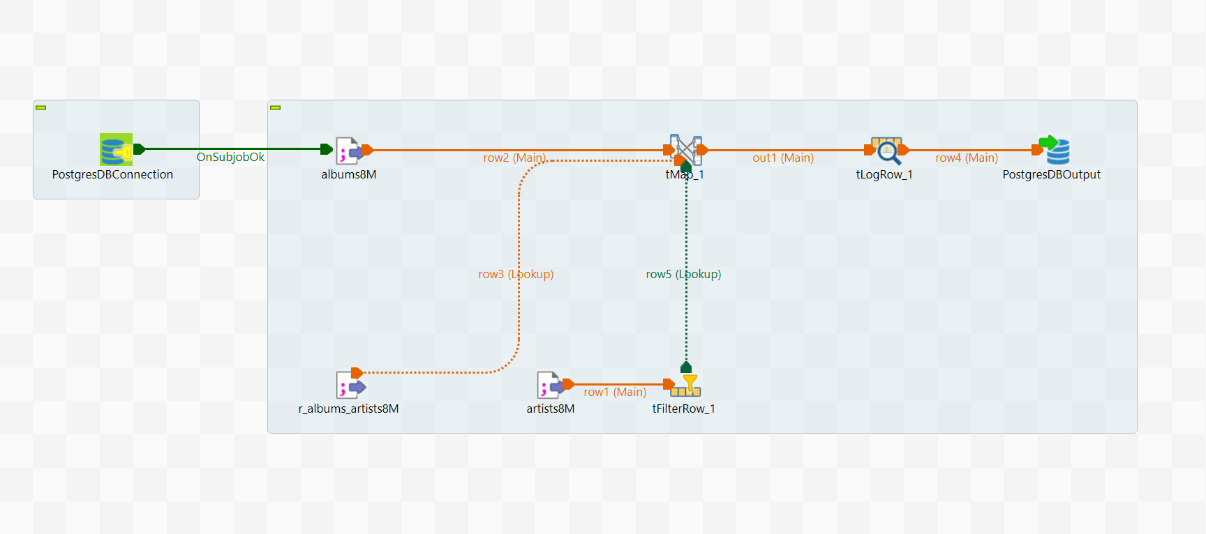
Albums
Notes:
Then we have the job for Albums, which is pretty similar to the one for songs.

Slide 38
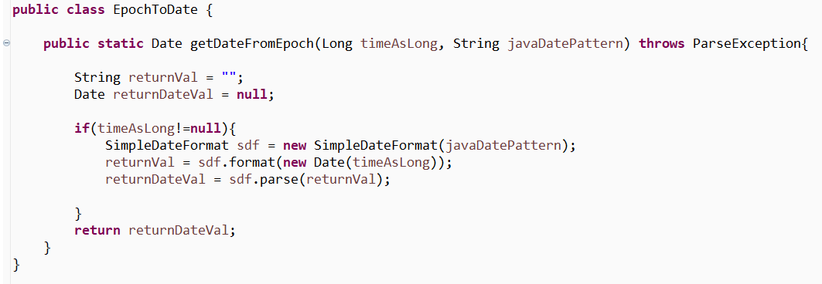
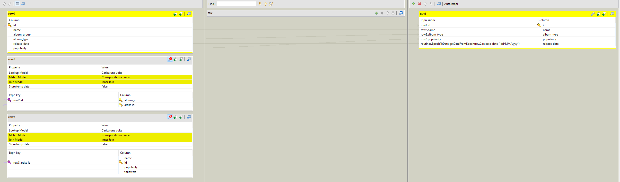
Albums - tMap
Notes:
And also here in the tMap component I needed to define a global routine, this time because the realease date attribute of albums was stored in the epoch format, so to make it more understandable it was needed to convert it in the Date format

Slide 39
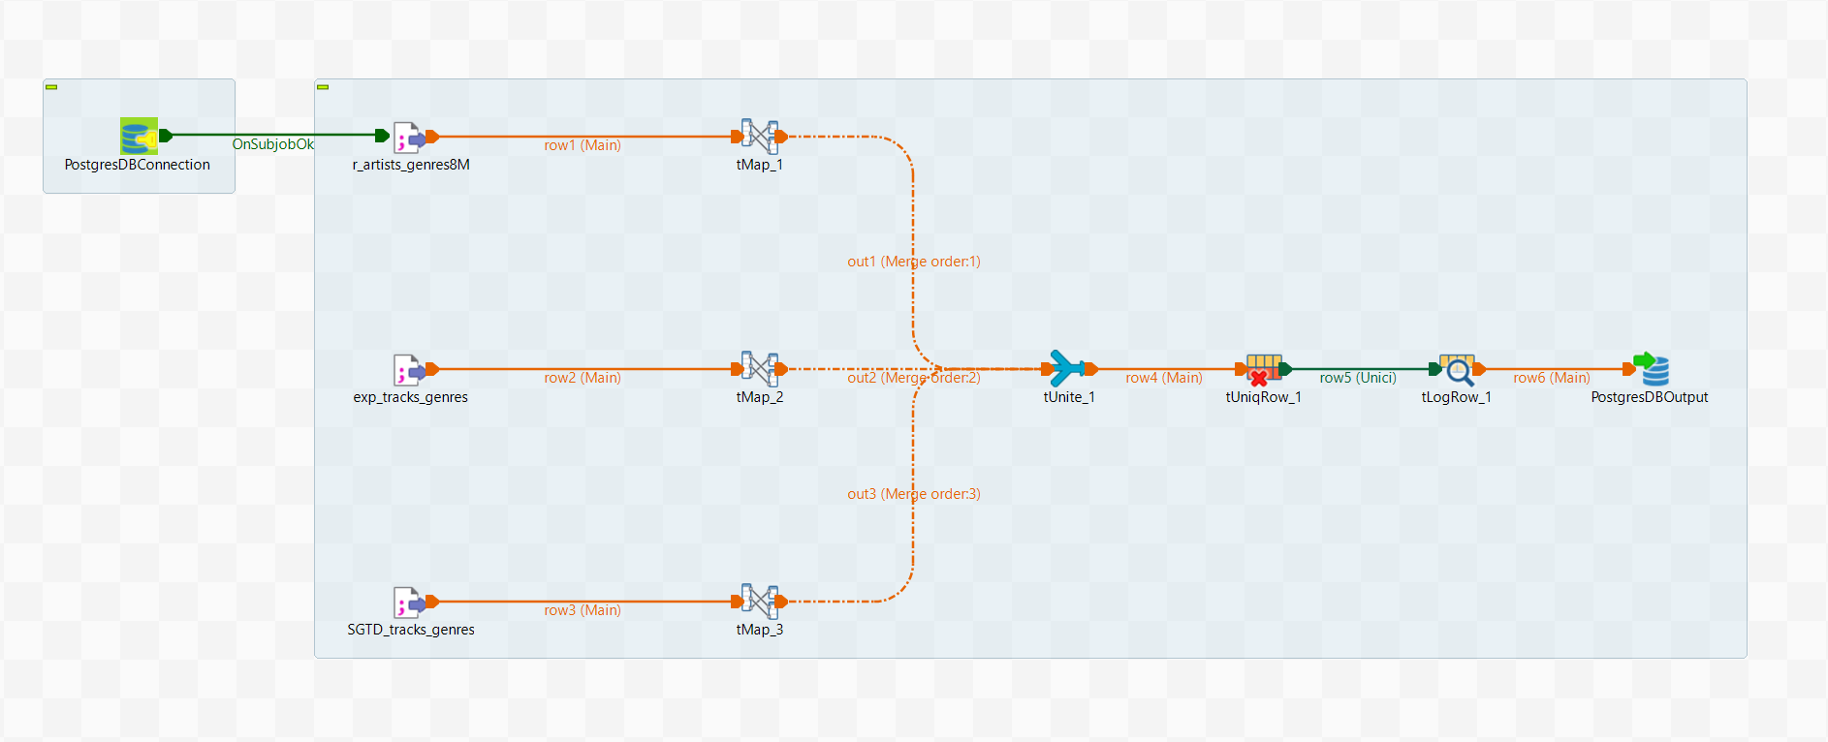
Genres
Notes:
Then we have the job for genre and the one for doesGenre, which are conceptually the same, as for both of them we need to consider the 3 data sources that we have for genres and unite and filter the duplicated tuples, … CONTINUA ALLA SLIDE DOPO

Slide 40
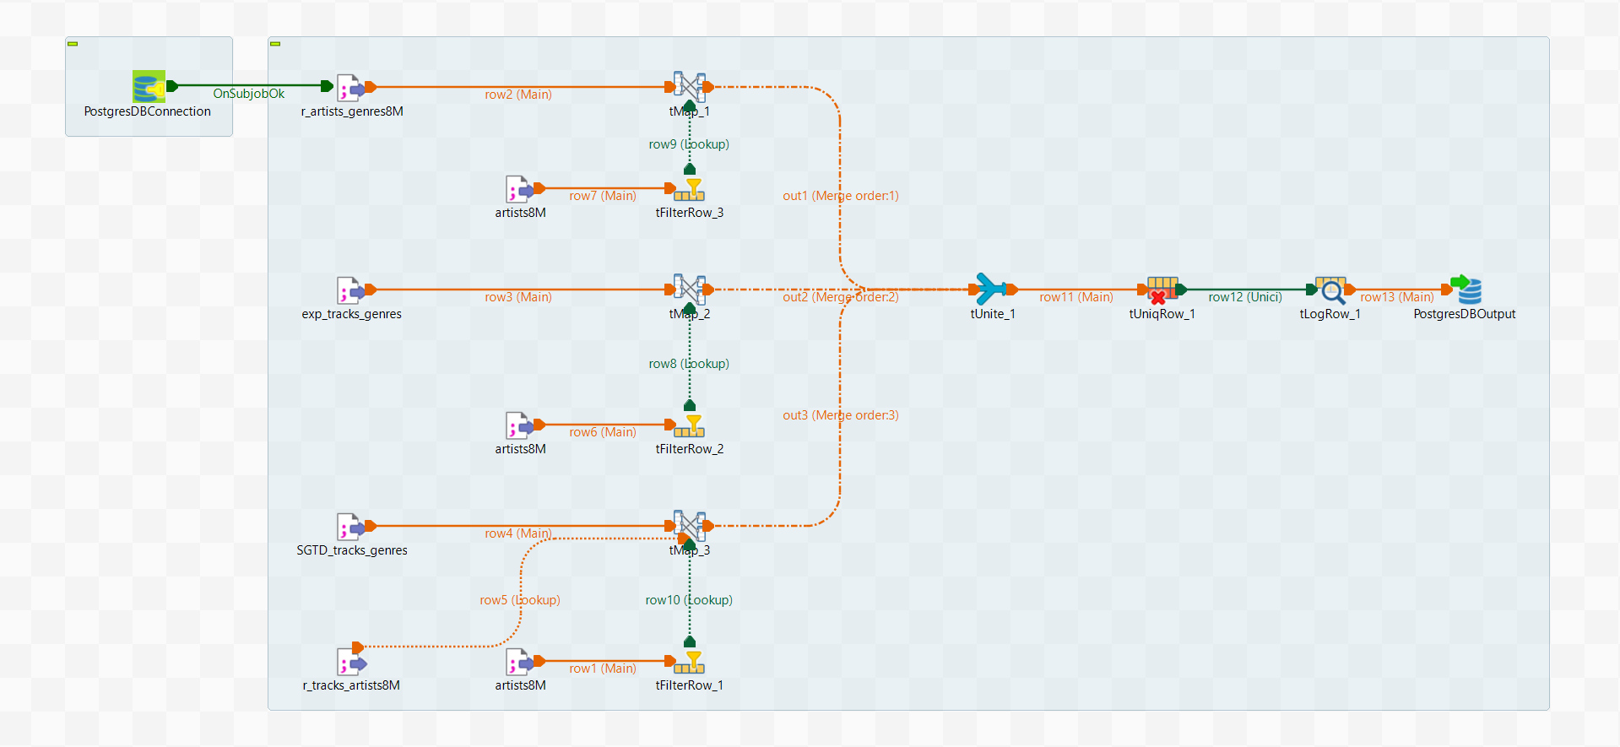
doesGenre
Notes:
the only difference is that for genre we just need the genre name, while for doesGenre as we see is more complicated beacuse for each of the 3 data sources we also need to check whether the artist we are considering is of our interest, meaning that it has popularity greater than 50

Slide 41
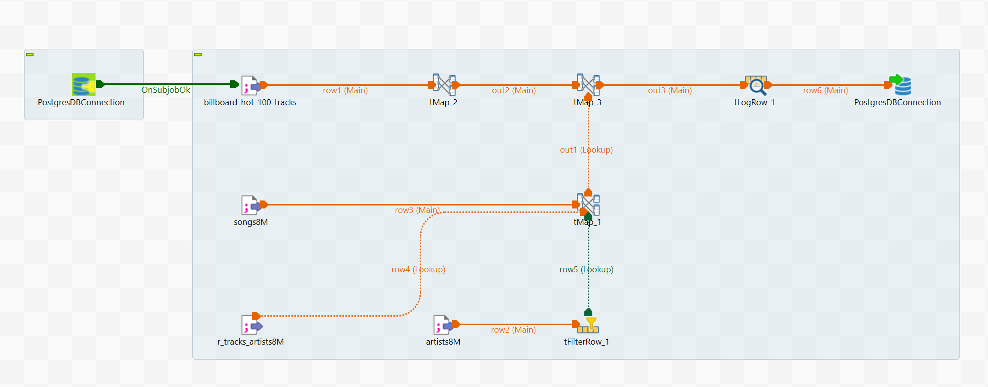
BillboardHot100Song
Notes:
Then we have BillboardSongs and hasLyrics, for which the structure is pretty similar, because this time, since we have just the name of the song and the artist, and not the spotify id, we need to check whether the specific song is of a particular artist of our interest. And I also needed to map the names in lowercase, because it may happen that the names were stored in different ways in the various data sources, and this is done in particular in tMap2 and tMap1.

Slide 42
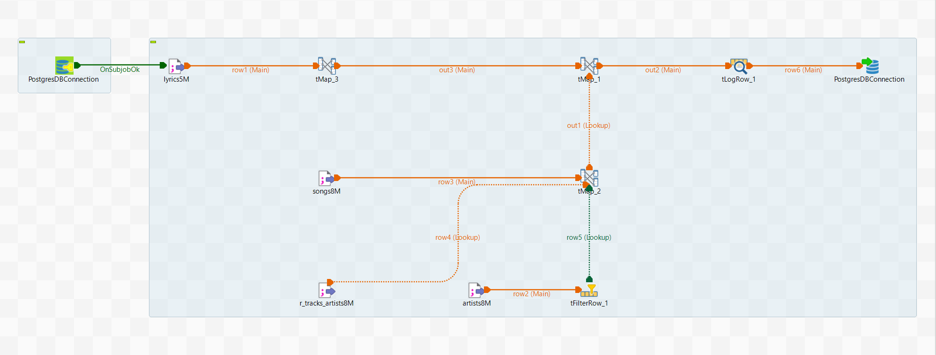
hasLyrics
Notes:
The we have the jobs for BillboardSong and hasLyrics, in which the structure is very similar and in which, in paritcular, now the lookup is performed now not by considering the spotify ids, because we dont’ have this information in our lyrics and billboard data source, but considering the song name and the artist name, so it is for this reason that is time the lookup is a bit more complex. And here I also needed to define a first mapping just for converting the names into lowercase becuse it may happen that they were stored in different case formats (AGGIUNGERE QUESTO PROBLEMA NELLA SLIDE DEI PROBLEMI)

Slide 43
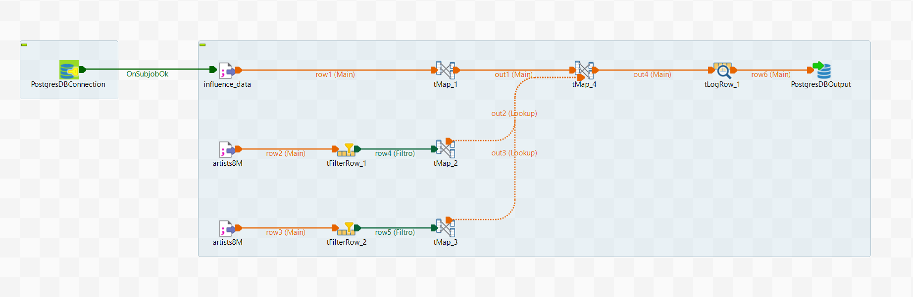
hasInfluenced
Notes:
Then we have hasInlfuenced, and also here, not having the spotify artist_id but just the name it was needed to map the name to lowercase and then make the lookup based on the two artist names, so follower and influcencer

Slide 44
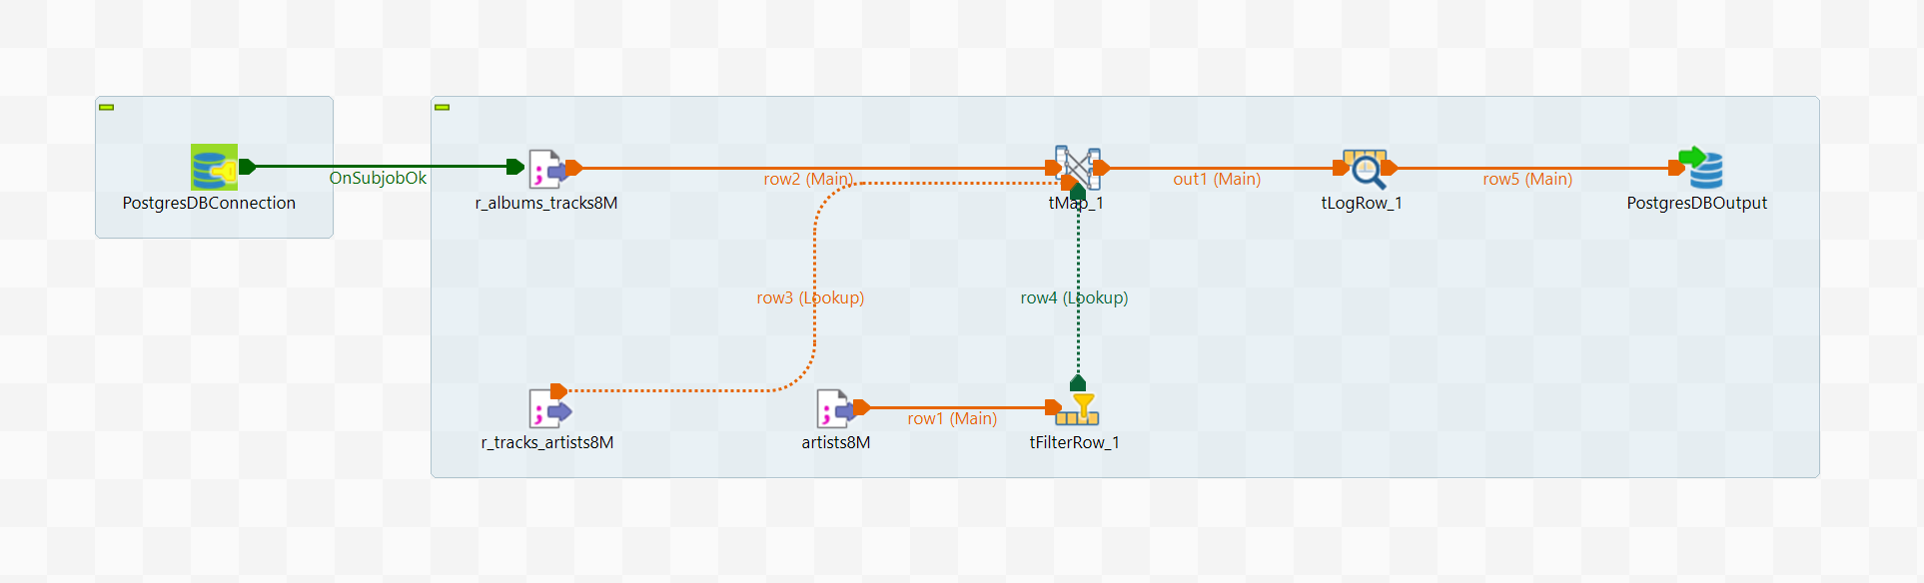
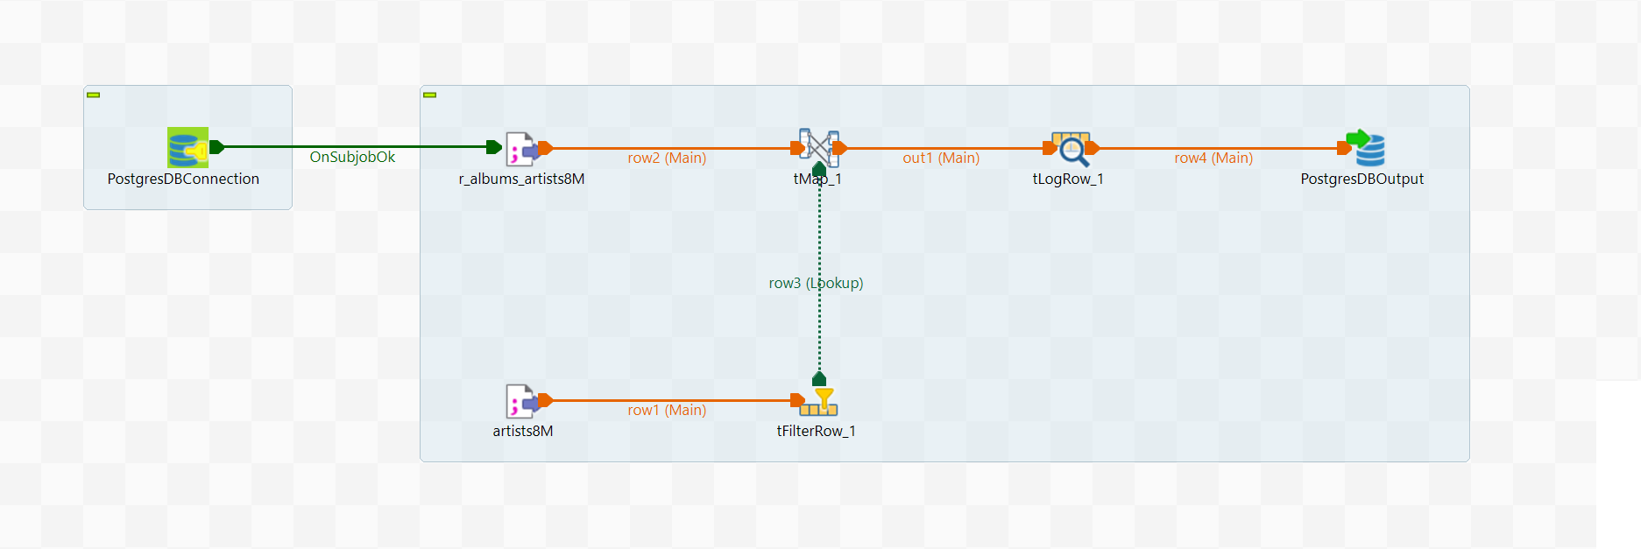
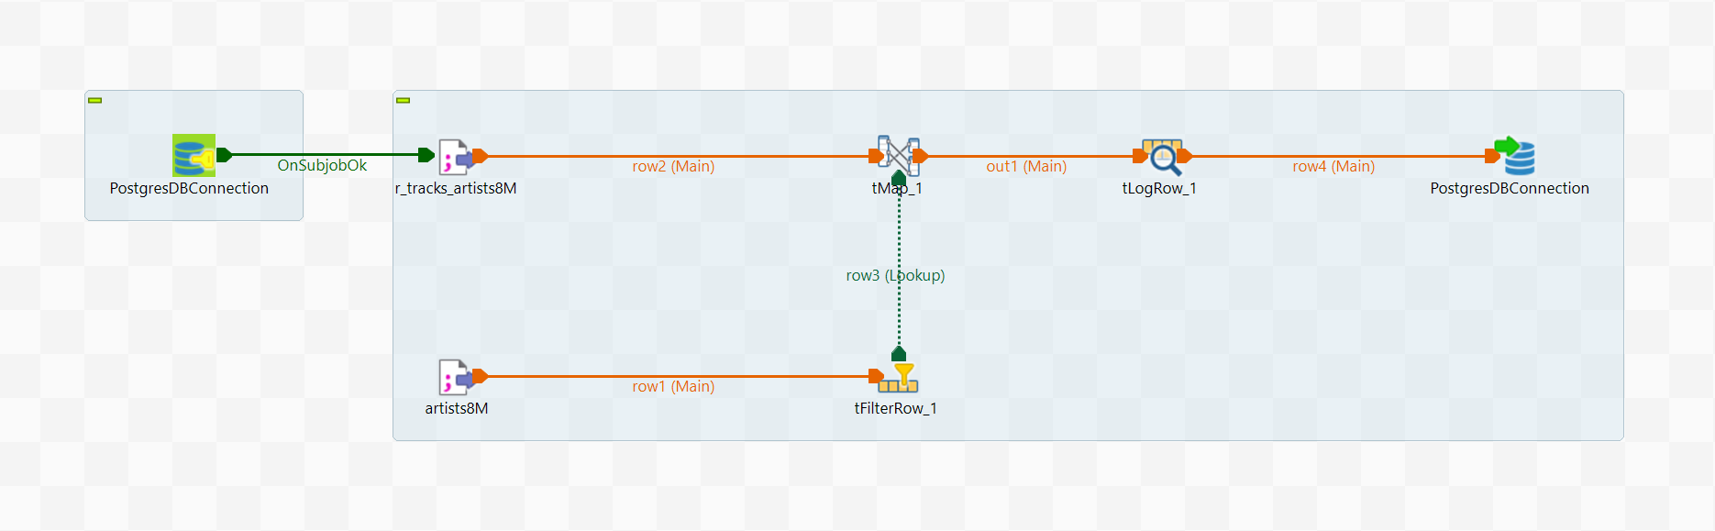
isSongOf – isAlbumOf – isSongInAlbum
Notes:
Then we have our binary relationships isSongOf, isAlbumOf and isSongInAlbum, which are not very interesting since have a very similar structure as before

Slide 45
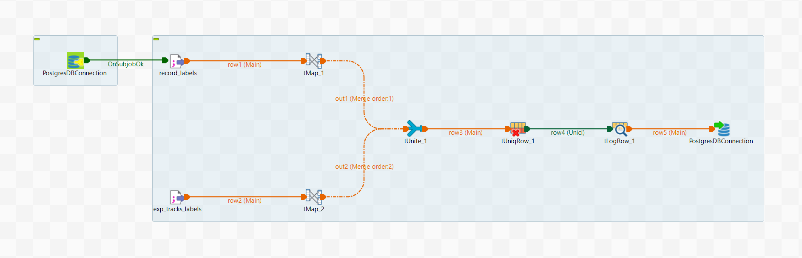
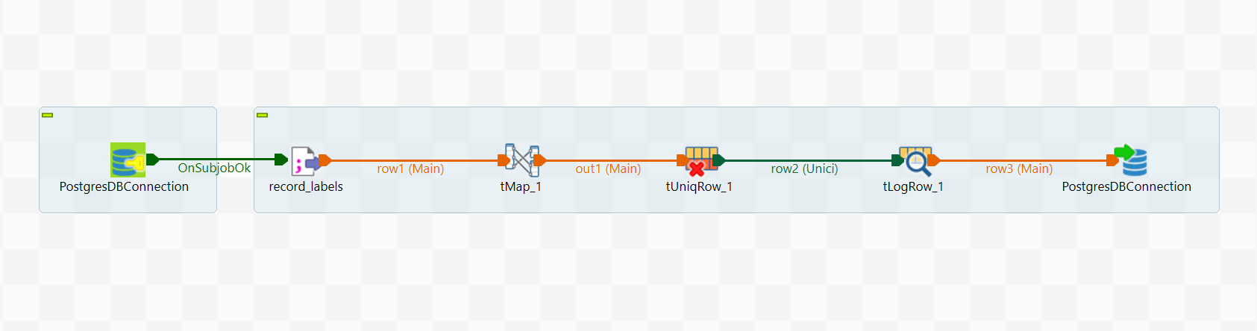
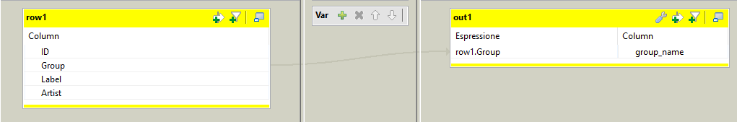
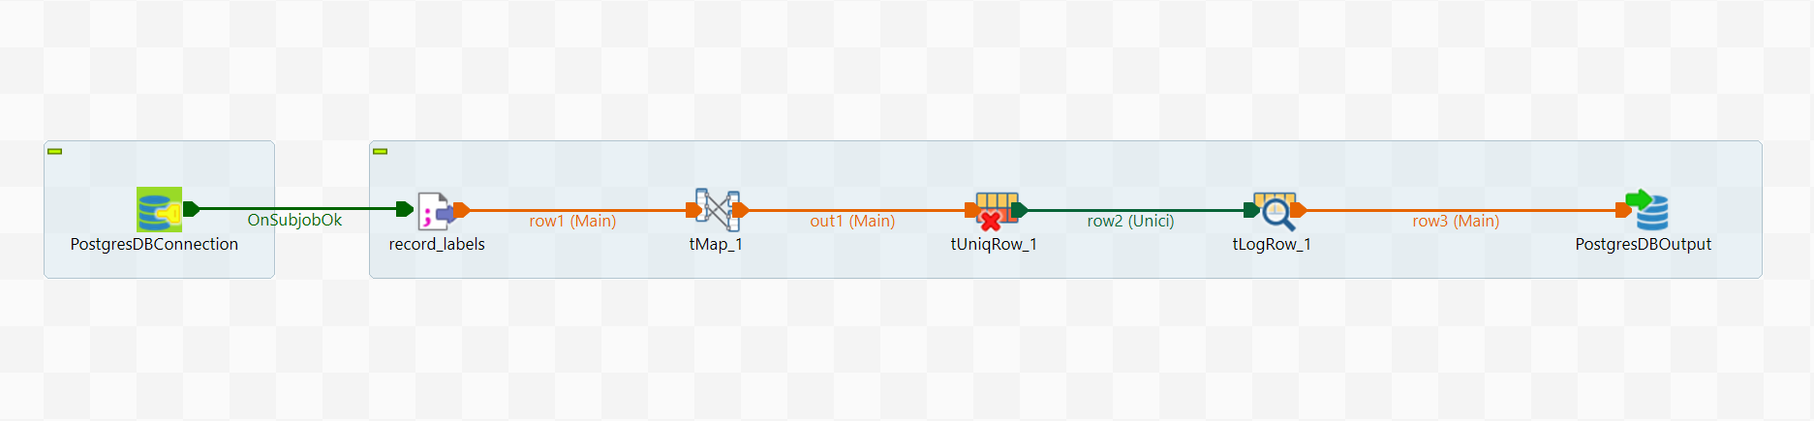
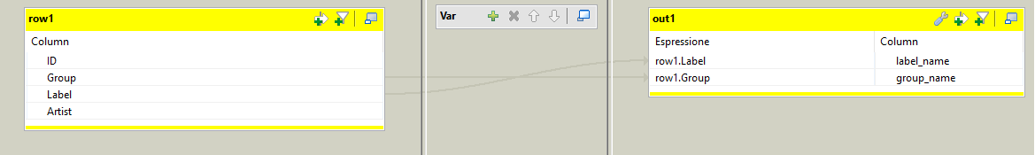
Label – Group - isLabelInGroup
Notes:
And finally there are the 3 jobs for Labels, Label Groups and isLabelInGroup relationship, where for Labels we had the information from two different data sources, so we perform the mapping of the label name and then we unite and filter the duplicates
While for LabelGroups and isLabelInGroup relationships the job looks actually the same, the difference is simply in the mapping because for Groups we take just the group_name while for isLabelInGroup relationship we need to map the label_name to the group_name

Slide 46
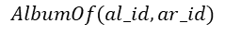
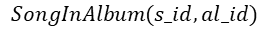
Query 1 - FOL
Find Albums of Artists with more than 500k followers that contain Songs that are present in the Billboard Hot 100 Chart at least 10 years after their release
$q=\{(album_name, artist_name, song_name, billboard_date, release_date, rank, peak_rank)$ |
$$∃ al_id, al_type, al_pop, ar_id, ar_pop, foll, s_id, s_pop, t_num, dur,exp, prev_url, woc .$$
$$Album(al_id, album_name,′album′,al_pop, release_date)$$
$$⋀$$
$$AlbumOf(al_id,ar_id)$$
$$⋀$$
$$Artist(ar_id, artist_name,ar_pop,foll)$$
$$⋀$$
$$SongInAlbum(s_id,al_id)$$
$$⋀$$
$$Song(s_id, song_name,s_pop,t_num,dur,exp,prev_url)$$
$$⋀$$
$$BillboardSong(s_id, rank,billboard_date,woc,peak_rank)$$
$$⋀$$
$$(foll>500000) ⋀ ((billboard_date / release_date)≥10)\}$$

Slide 47
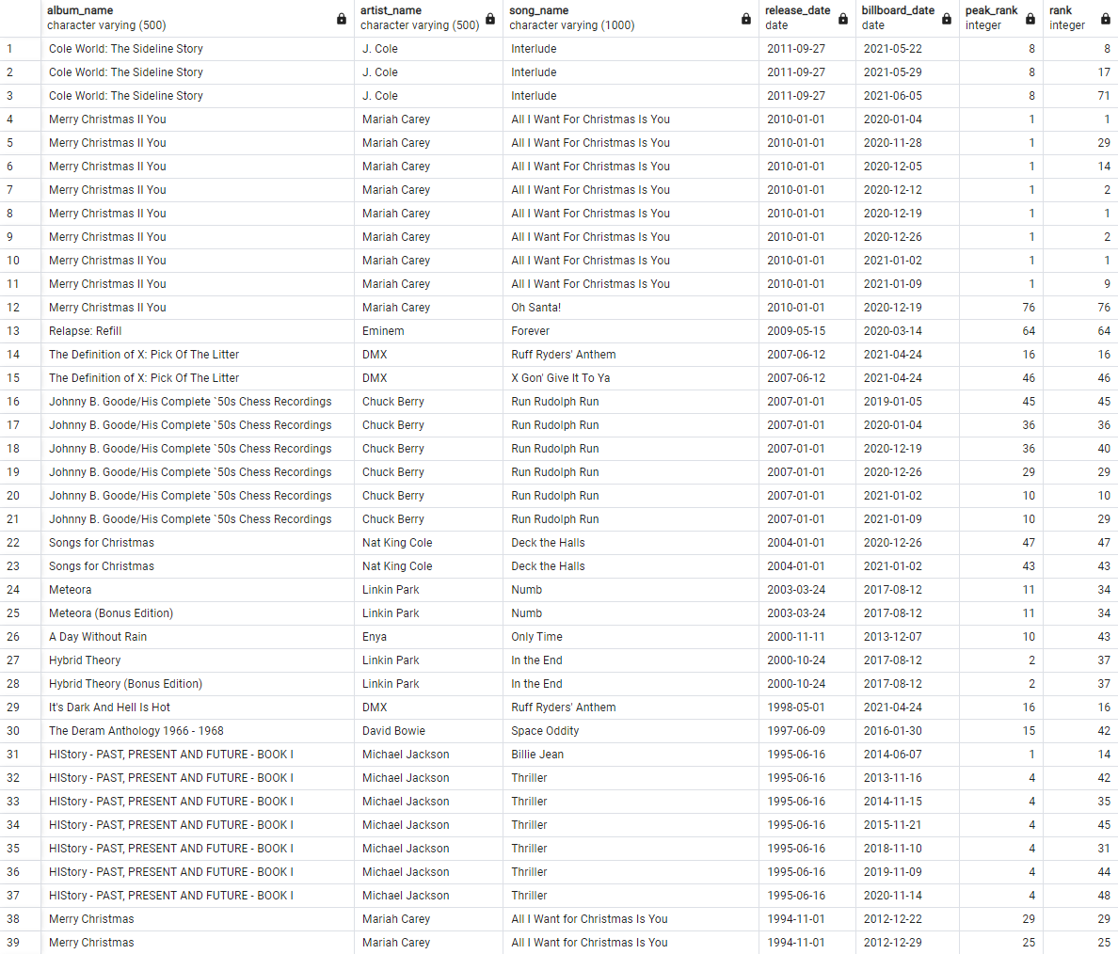
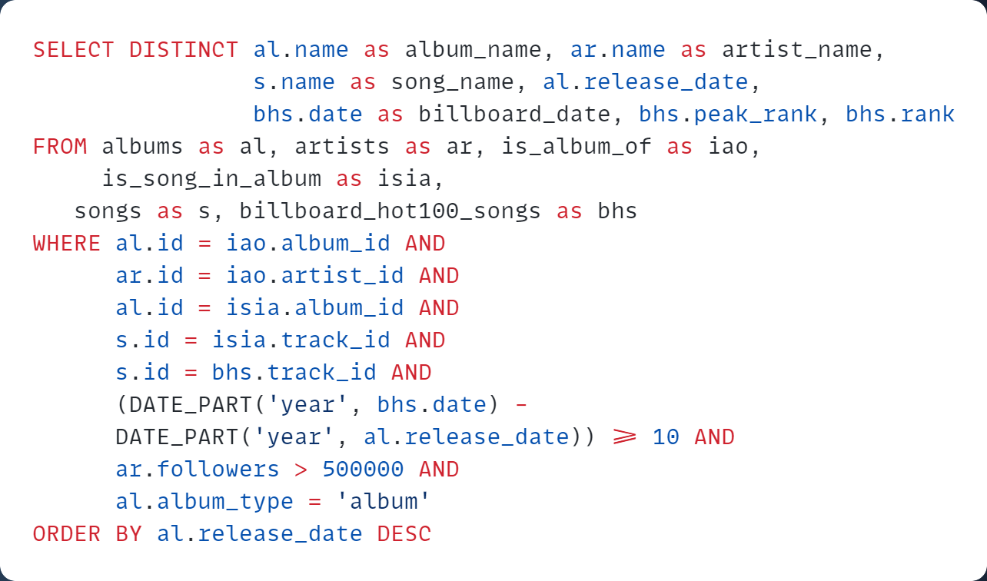
Query 1 - SQL
Find Albums of Artists with more than 500k followers that contain Songs that are present in the Billboard Hot 100 Chart at least 10 years after their release

Slide 48
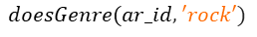
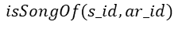
Query 2 - FOL
Find acousticness, danceability, energy and loudness of Songs of Artists that do the ‘rock’ Genre and that reached the #1 of the Billboard Hot 100 Chart
$q=\{(song_name, artist_name, acousticness, danceability, energy, loudness, billboard_date)$ |
$$∃ ar_id, ar_pop, foll, genre,s_id, s_pop, t_num, dur,exp, prev_url,woc, peak_rank,i,k,l,m,s,t,ts.$$
$$Artist(ar_id, artist_name,ar_pop,foll)$$
$$⋀$$
$$doesGenre(ar_id,′rock′)$$
$$⋀$$
$$isSongOf(s_id,ar_id)$$
$$⋀$$
$$Song(s_id, song_name,s_pop,t_num,dur,exp,prev_url)$$
$$⋀$$
$$BillboardSong(s_id, 1,billboard_date,woc,peak_rank)$$
$$⋀$$
$$AudioFeature(s_id, acousticness, danceability, energy, i, k, l, loudness, m, s, t, ts)\}$$

Slide 49
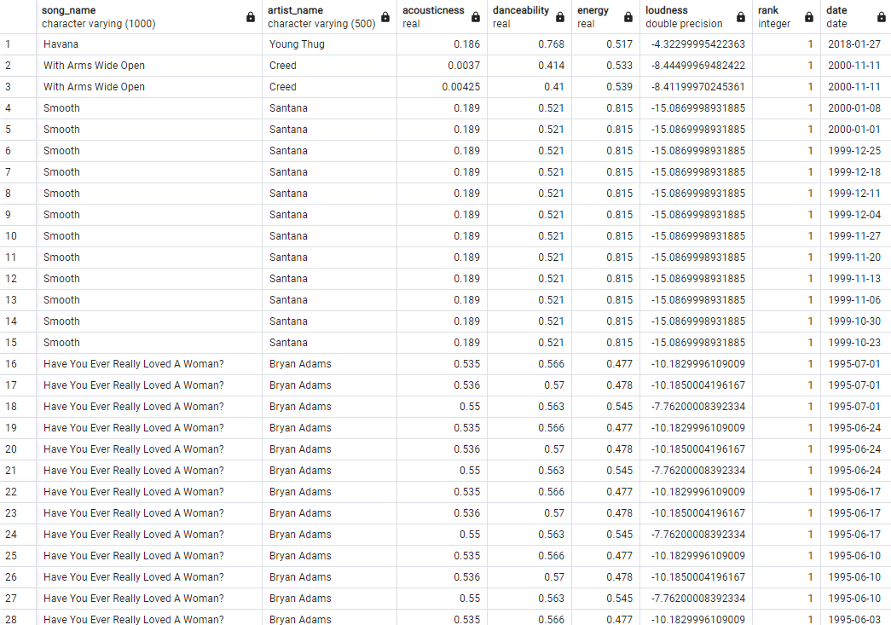
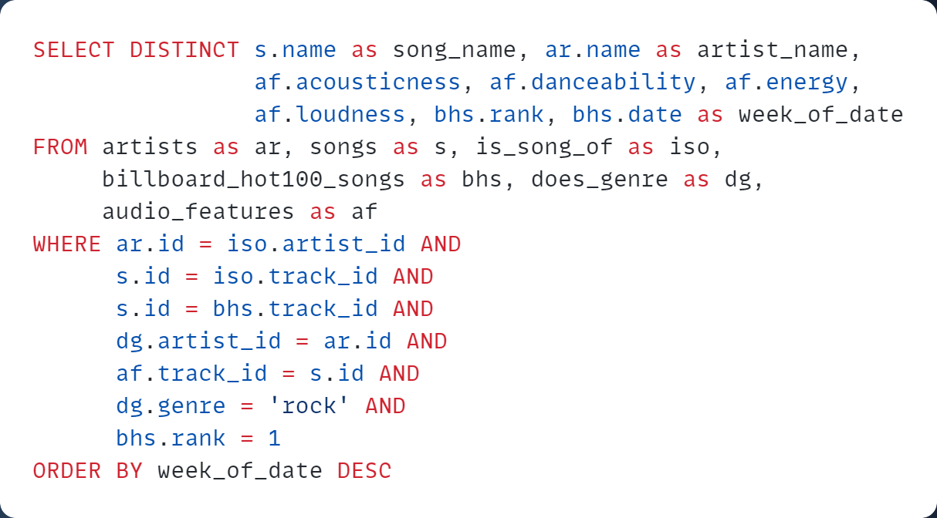
Query 2 - SQL
Find acousticness, danceability, energy and loudness of Songs of Artists that do the ‘rock’ Genre and that reached the #1 of the Billboard Hot 100 Chart
Notes:
Apart from Havana, which is actually a pop song as we can see from the level of danceability which is pretty high, here we get the insight that it is since the year 2000
That an artist that does the rock genre does not reach the number 1 position in the Billbord chart

Slide 50
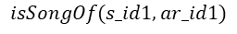
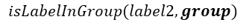
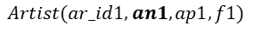
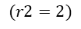
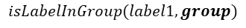
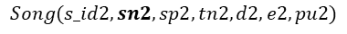
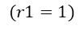






Query 3 - FOL
Top 2 songs on Billboard in the same week of two different artists that belong to two different labels but of the same Group of labels.
$q=\{(an1, sn1,r1,an2, sn2,r2,group,week_of_date)$ |
$$∃ sid1,woc1,pr1,sid2,woc2,pr2,arid1,arid2,sp1,tn1,d1,e1,pu1,sp2,tn2,d2,e2,pu2,ap1,f1,ap2,f2,label1,label2 .$$
$$BillboardSong(s_id1, r1,week_of_date,woc1,pr1)$$
$$⋀$$
$$BillboardHot100Song(s_id2, r2,week_of_date,woc2,pr2)$$
$$isSongOf(s_id1,ar_id1)$$
$$⋀$$
$$isSongOf(s_id2,ar_id2)$$
$$⋀$$
$$Song(s_id1, sn1,sp1,tn1,d1,e1,pu1)$$
$$Song(s_id2, sn2,sp2,tn2,d2,e2,pu2)$$
$$⋀$$
$$⋀$$
$$Artist(ar_id1, an1,ap1,f1)$$
$$⋀$$
$$Artist(ar_id2, an2,ap2,f2)$$
$$hasLabel(a_id1, label1)$$
$$⋀$$
$$hasLabel(a_id1,label2)$$
$$⋀$$
$$isLabelInGroup(label1, group)$$
$$⋀$$
$$isLabelInGroup(label2,group)$$
$$(r1=1)$$
$$⋀$$
$$(r2=2)$$
$$⋀$$
$¬(ar_id1=ar_id2)$
$$⋀$$
$¬(label1=label2)\}$

Slide 51


Query 3 - SQL
Top 2 songs on Billboard in the same week of two different artists that belong to two different labels but of the same Group of labels.
Notes:
And for instance in the results we have that this has been the case for the Interscope Geffen A&M group of labels, with Lose Yourself of Eminem, that was in the first position and Dilemma by Kelly Rowland and Nelly in the second position for just one week in 2002 and also for one sone of 50 Cent and one of Sean Paul

Slide 52












Query 4 - FOL
Find which albums contain a song that is a featuring between «Machine Gun Kelly» and another artist who belongs to his same label
$q=\{(aname2,sname,albname,aname3,releasedate)$ |
$$∃aid1,p,f,sid1,sid2,aid2,p2,f2,label1,label2,sp,tn,d,e,pu,albid,at,abp,aid3,p3,f3.$$
$$Artist(aid1,′Machine Gun Kelly^{′},p,f)$$
$$⋀$$
$$isSongOf (sid1,aid1)$$
$$⋀$$
$$isSongOf (sid2,aid2)$$
$$⋀$$
$$(sid1=sid2)$$
$$⋀$$
$$¬(aid1=aid2)$$
$$⋀$$
$$Artist(aid2,aname2,p2,f2)$$
$$⋀$$
$$hasLabel(aid1,label1)$$
$$⋀$$
$$hasLabel(aid2,label2)$$
$$⋀$$
$$(label1=label2)$$
$$⋀$$
$$Song(sid1,sname,sp,tn,d,e,pu)$$
$$⋀$$
$$isSongInAlbum(sid1,albid)$$
$$⋀$$
$$Album(albid,albname,at,abp,releasedate)$$
$$⋀$$
$$isAlbumOf(albid,aid3)$$
$$⋀$$
$$Artist(aid3,aname3,p3,f3)\}$$

Slide 53


Query 4 - SQL
Find which albums contain a song that is a featuring between «Machine Gun Kelly» and another artist who belongs to his same label
Notes:
And here is the SQL version of the query and the results, and as we can notice we have only 4 artists in the results, and we have also the information about who is the owner of the album, so for isntance in the case of a single we have all the singers that participate in the song are also the owners of the album while of course there are also some featuings that are present in an effective album of one particular artist, for instance weird! From YUNGBLUD and Tickets To My Downfall of Machine Gun Kelly

Slide 54







Query 5 - FOL
Artists that have been influenced by «Nirvana» and that have done a featuring with each other that reached the Billboard Hot 100 Chart
$q=\{(song_name,foll1_name,foll2_name,peak_rank)$ |
$$∃ infl_aid, ip,if,foll1_aid,foll2_aid,sid1,sid2,sp,tn,d,e,pu,fp1,fp2,ff1,ff2,r,wod,woc.$$
$$Artist(infl_aid, ′Nirvana′,ip,if)$$
$$⋀$$
$$hasInfluenced(infl_aid, foll1_aid)$$
$$⋀$$
$$hasInfluenced(infl_aid,foll2_aid)$$
$$⋀$$
$$¬(foll1_aid=foll2_aid)$$
$$⋀$$
$$isSongOf(sid1,foll1_aid)$$
$$⋀$$
$$isSongOf(sid2,foll2_aid)$$
$$⋀$$
$$(sid1=sid2)$$
$$⋀$$
$$Song(sid1, song_name,sp,tn,d,e,pu)$$
$$⋀$$
$$Artist(foll1_aid, foll1_name,fp1,ff1)$$
$$⋀$$
$$Artist(foll2_aid, foll2_name,fp2,ff2)$$
$$⋀$$
$BillboardHot100Song(sid1, r,wod,woc,peak_rank)$}

Slide 55


Query 5 - SQL
Artists that have been influenced by «Nirvana» and that have done a featuring with each other that reached the Billboard Hot 100 Chart
Notes:
This is the Query in SQL and we have also the results, and as we can see we have one single songs, which is Under Pressure by My Chemical Romance and The Used, which is actually a cover of the original song by The Queen with David Bowie

Slide 56
Query 6 - FOL
Lyrics of songs with popularity ≥ 80, of artists with popularity ≥ 80, that do either «alternative rock» or «alternative metal» or «punk» music genre
$q=\{(aname,apopularity,sname,spopularity,lyrics)$ |
$$(∃ aid, af,sid,tn,d,e,pu.$$
$$Artist(aid, aname,apopularity,af)$$
$$⋀$$
$$(apopularity≥80)$$
$$⋀$$
$$isSongOf(sid,aid)$$
$$⋀$$
$$Song(sid, sname,spopularity,tn,d,e,pu)$$
$$⋀$$
$$(spopularity≥80)$$
$$⋀$$
$$doesGenre(aid, "alternative rock")$$
$$⋀$$
$$hasLyrics(sid,lyrics))$$
$$⋁$$
$$(∃ aid, af,sid,tn,d,e,pu.$$
$$Artist(aid, aname,apopularity,af)$$
$$⋀$$
$$(apopularity≥80)$$
$$⋀$$
$$isSongOf(sid,aid)$$
$$⋀$$
$$Song(sid, sname,spopularity,tn,d,e,pu)$$
$$⋀$$
$$(spopularity≥80)$$
$$⋀$$
$$doesGenre(aid, "alternative metal")$$
$$⋀$$
$$hasLyrics(sid,lyrics))$$
$$⋁$$
$$(∃ aid, af,sid,tn,d,e,pu.$$
$$Artist(aid, aname,apopularity,af)$$
$$⋀$$
$$(apopularity≥80)$$
$$⋀$$
$$isSongOf(sid,aid)$$
$$⋀$$
$$Song(sid, sname,spopularity,tn,d,e,pu)$$
$$⋀$$
$$(spopularity≥80)$$
$$⋀$$
$$doesGenre(aid, "punk")$$
$$⋀$$
$$hasLyrics(sid,lyrics))\}$$

Slide 57


Query 6 - SQL
Lyrics of songs with popularity ≥ 80, of artists with popularity ≥ 80, that do either «alternative rock» or «alternative metal» or «punk» music genres
Notes:
This is the Query in SQL and we have also the results, and as we can see we have one single songs, which is Under Pressure by My Chemical Romance and The Used, which is actually a cover of the original song by The Queen with David Bowie

Slide 58
Thanks!

